Slide 1

Unit 3
Could you please tell me where
the restrooms are?
Section A 1a-3b
第一PPT模板网-WWW.1PPT.COM

Slide 2

Objectives
Learn how to ask for information
politely
2. Follow directions

Slide 3
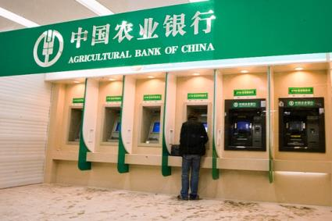
Where can we …?
take out
get some money
save money
存钱
bank

Slide 4
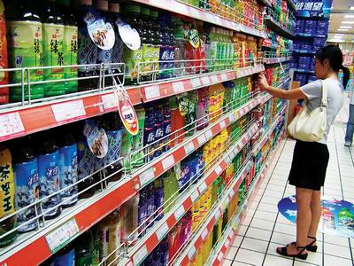
Where can we …?
get a pair of shoes
supermarket
department store 百货公司

Slide 5
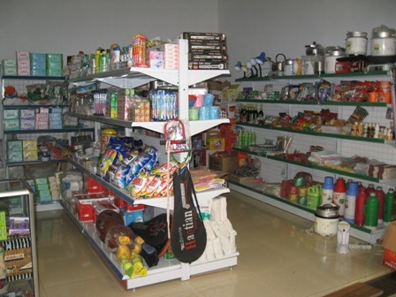
Where can we …?
buy snacks
PPT模板：www.1ppt.com/moban/ PPT素材：www.1ppt.com/sucai/
PPT背景：www.1ppt.com/beijing/ PPT图表：www.1ppt.com/tubiao/
PPT下载：www.1ppt.com/xiazai/ PPT教程： www.1ppt.com/powerpoint/
资料下载：www.1ppt.com/ziliao/ 范文下载：www.1ppt.com/fanwen/
试卷下载：www.1ppt.com/shiti/ 教案下载：www.1ppt.com/jiaoan/
PPT论坛：www.1ppt.cn PPT课件：www.1ppt.com/kejian/
语文课件：www.1ppt.com/kejian/yuwen/ 数学课件：www.1ppt.com/kejian/shuxue/
英语课件：www.1ppt.com/kejian/yingyu/ 美术课件：www.1ppt.com/kejian/meishu/
科学课件：www.1ppt.com/kejian/kexue/ 物理课件：www.1ppt.com/kejian/wuli/
化学课件：www.1ppt.com/kejian/huaxue/ 生物课件：www.1ppt.com/kejian/shengwu/
地理课件：www.1ppt.com/kejian/dili/ 历史课件：www.1ppt.com/kejian/lishi/
daily’s department store
Notes:
PPT模板：www.1ppt.com/moban/ PPT素材：www.1ppt.com/sucai/
PPT背景：www.1ppt.com/beijing/ PPT图表：www.1ppt.com/tubiao/
PPT下载：www.1ppt.com/xiazai/ PPT教程： www.1ppt.com/powerpoint/
资料下载：www.1ppt.com/ziliao/ 范文下载：www.1ppt.com/fanwen/
试卷下载：www.1ppt.com/shiti/ 教案下载：www.1ppt.com/jiaoan/
PPT论坛：www.1ppt.cn PPT课件：www.1ppt.com/kejian/
语文课件：www.1ppt.com/kejian/yuwen/ 数学课件：www.1ppt.com/kejian/shuxue/
英语课件：www.1ppt.com/kejian/yingyu/ 美术课件：www.1ppt.com/kejian/meishu/
科学课件：www.1ppt.com/kejian/kexue/ 物理课件：www.1ppt.com/kejian/wuli/
化学课件：www.1ppt.com/kejian/huaxue/ 生物课件：www.1ppt.com/kejian/shengwu/
地理课件：www.1ppt.com/kejian/dili/ 历史课件：www.1ppt.com/kejian/lishi/

Slide 6

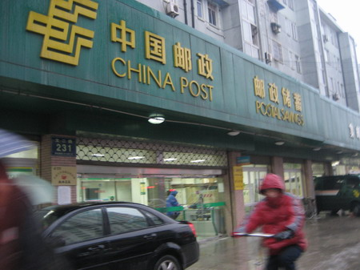
Where can we …?
buy some stamps
and post a letter
post office

Slide 7
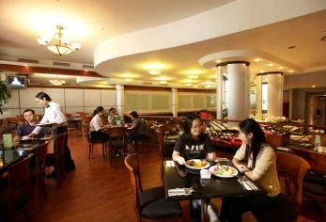
Where can we …?
rest and drink coffee have dinner
Could you please tell me where we can …?
restaurant

Slide 8
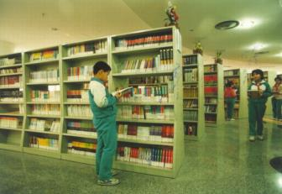
Where can we …?
borrow some books get some information about the town
Could you please tell me where
we can …?
library

Slide 9

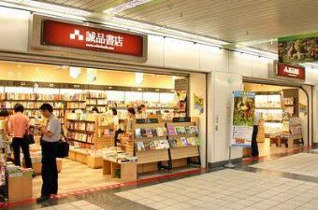
Where can we …?
get some magazines
Could you please tell me
where we can …?
book store

Slide 10
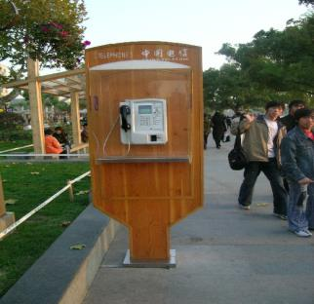
Where can we …?
make a telephone call
打电话
Could you please tell me
where we can …?
telephone booth电话亭

Slide 11
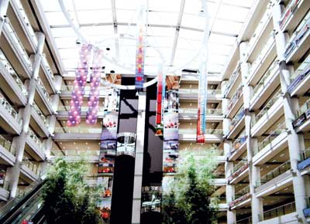
Where can we …?
hang out
Could you please tell me where we can …?
Mall 购物商场

Slide 12
问路的常用句型
Excuse me. Could/Can you tell me the way to…?
Excuse me. Could/Can you tell me how I can get to…?
Excuse me. Could/Can you tell me how to get to…?
Excuse me. Could/Can you tell me where…is/are?
Excuse me. Do you know where/how…?
Excuse me. Which is the way to…, please?
Excuse me. Where is …, please？
Excuse me. Is there a/an…near here?

Slide 13
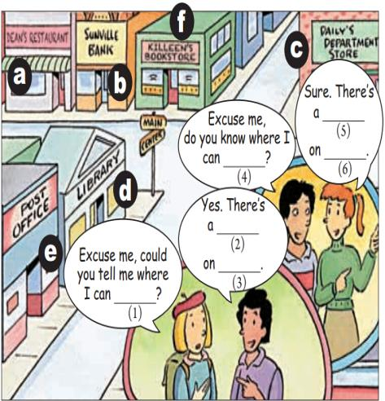
1a Where can you do the things below? Match each thing with a place in the picture. Many different answers are possible.
get some money ______
get some information about the town ______
get some magazines _____
buy a newspaper ______
have dinner ______
buy some stamps ______
get a dictionary _____
get a pair of shoes ____
b
d/f
d/f
f
a
e
d/f
c

Slide 14

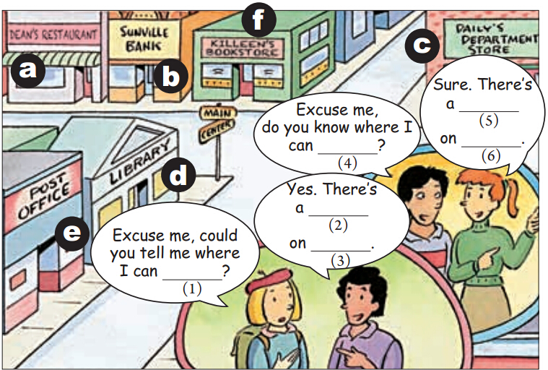
1b Listen and complete the conversations in
the picture in 1a.
bookstore
get a dictionary
Main Street
post office
Center Street
buy some stamps

Slide 15
directions

Slide 16
Turn left.
Turn right.
Go / Walk along … until …
Go past …

Slide 17
Where is ?
next to …
on the right
A
A
B
between … and …

Slide 18
1c Make conversations using the information in 1a. Then talk about your own town/ city.
A: Excuse me, could you please tell me how to
get to the bookstore?
B: Sure, just go along Main Street until you pass
Center Street. The bookstore is on your
right, beside the bank.
A: Thanks. Do you know when the bookstore
closes today?
B: It closes at 7:00 p.m. today.
c

Slide 19
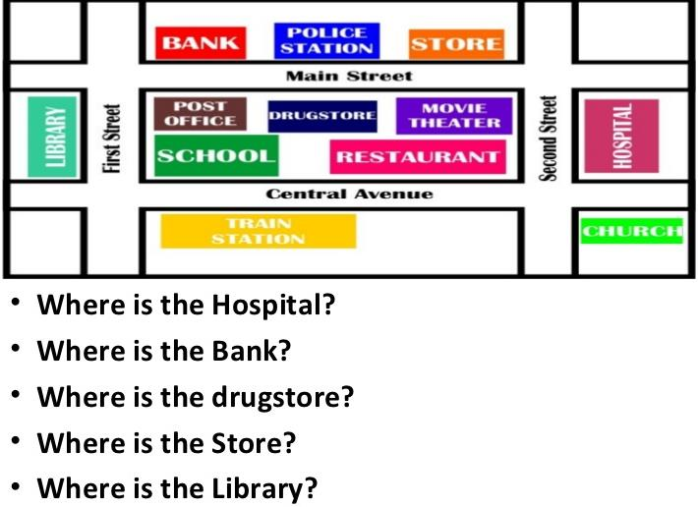
Pairwork
Make conversations.

Slide 20
A: Excuse me. Do you know where I
can mail a package?
B: Yes. The post office is on Main
Street. It’s just next to the
drugstore.
A: Thank you very much.

Slide 21
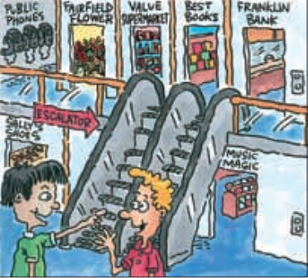
2a Listen. You will hear some of the directions below. Number the directions in the order that
you hear them.
____ Go to the third floor.
____ Turn left .
____ Go to the second floor.
____ Turn right.
____ The supermarket is between the flower store and the bookstore.
____ Go past the bookstore.
2
1
4
3

Slide 22
2b Listen again. Draw a line to show how the boy walks to the supermarket.

Slide 23

2c Make conversations about the other
places in the picture in 2a.
A: Excuse me, do you know where I can
get some postcards?
B: Sure. Go to the second floor. There’s
a bookstore between the bank and the
supermarket.

Slide 24
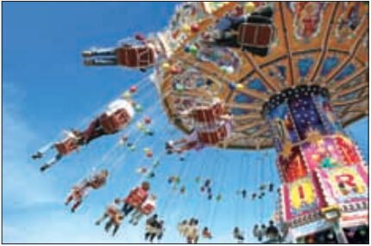
2d Role-play the conversation.
He Wei: This Fun Times Park , the biggest
amusement park in our city!
Alice: I’m excited to try the rides!
He Wei: What should
we start with ?
There’s Space
World, Water
World, Animal
World ...

Slide 25
Alice: Before we decide, could you first tell me
where the restrooms are?
He Wei: Pardon? Restroom? You want to rest?
But we haven’t even started yet!
Alice: Oh no, I don’t mean that. I mean ...
you know, a washroom or bathroom.
He Wei: Hmm ... so you mean ... the toilets?

Slide 26
Alice: Yes! Sorry, maybe people in China
don’t often use the word “restroom”
when they speak English.
He Wei: That's right. In China, we normally say
“toilet” or “washroom” in English.
Anyway, they’re over there.
Alice: OK. I’ll be quick!
He Wei: No problem. You don’t need to rush!

Slide 27

Watch and read

Slide 28
Language points
Excuse me, could you please tell me how to get to the bookstore?
打扰一下，你能告诉我怎样到达书店吗？
(1) Excuse me. 是英语中常用的的客套用语，其意思根据不同情境理解为“请问”“请原谅”“不好意思，打扰一下”等。如：
Excuse me, just a minute, please.
对不起，稍等一下。
Excuse me, could you tell me how to get to No.1 Middle School?
打扰了，你能告诉我怎样去第一中学吗？

Slide 29
拓展：
问路的常用句型
Excuse me. Could/Can you tell me the way to…?
Excuse me. Could/Can you tell me how I can get to…?
Excuse me. Could/Can you tell me how to get to…?
Excuse me. Could/Can you tell me where…is/are?
Excuse me. Do you know where/how…?
Excuse me. Which is the way to…, please?
Excuse me. Where is …, please？
Excuse me. Is there a/an…near here?

Slide 30
(2) Could you please…? “请你……好吗？”
否定式为“Could you please not…” “请你
别……好吗”交际用语，表示有礼貌的提出
请求，后接动词原形。
Could you please tell me where the bookstore is?
请你告诉我书店在哪里好吗？
Could you please not stand here?
请别站在这儿好吗？

Slide 31
拓展：
表示委婉请求及请求允许做某事的句型
Could you please do sth.?
Would/Will you please do sth.?
Would you like to do sth.?
May/Can/Could I do sth.?
肯定回答常用：Sure./Of course./ No problem./
I’d love to.等。
否定回答常用：Sorry, I’d love/like to, but I…/
Sorry, I’m afraid …等。

Slide 32
2. Sure, just go along Main Street until you pass
Center Street.
当然，就沿着主街向前走，一直到你经过中心大街。
go along 表示“沿着……向前走”多指沿着街道、河边或堤坝等向前走，指路常用语。
go down也表示“沿着……向前走”，但其多指向
低处走，或向郊区走
Go along this street, and you will find the park in the end.
沿着这条街向前走，在路的尽头你会找到那个公园。

Slide 33
拓展：
常见的指路表达方式
Turn left/right at… 在……往左/往右转。
Turn right at the third crossing, and then walk
straight.
在第三个十字路口往右转，然后朝前直走。
Take the first/second…turning on the right/left.
在第一/二……个拐弯处往右、左拐。
Take the second turning on the right.
在第二个拐弯处往右拐。

Slide 34
It’s across from/near/next to …
它就在……对面/附近/旁边。
It’s across from/near/next to the hospital.
他就在医院对面/附近/旁边。
You can take the NO. …bus and get off at…
你可以乘……路公共汽车在……下车。
You can take the NO.3 bus and get off at the National Park Stop.
你可以乘3路公共汽车在国家公园站下车。

Slide 35
(2) until 此处用作连词，意为“直到……时为止”。
A. 用于肯定句。
Please wait here until I come.
请在这里等到我来。
He ran until he was breathless.
他一直跑到气喘吁吁才停下。
注意：作连词的until用于肯定句中，表示主句的 动作一直持续到从句动作发生或状态出现时为止，一般可译为“直到……为止”。在这种用法中，主句的谓语动词必须是延续性动 词（非瞬间性动词），如 live, wait, last, love, like, stay, work, continue 等。

Slide 36
B. 用于否定句中，构成“not…until”结构，意
为“直到……才”
I hadn’t realized she was foreign until she spoke.
她不说话我还一直不知道她是个外国人。
I won’t stop shouting until you let me go.
你不放我走,我就一直喊叫。
注意：作连词的until用于否定句中，从句动作先发生，主句动作再发生。

Slide 37
C. until 用作介词，意为“直到某一时刻；直到发生某事”
It may last until Friday.
这可能要延续到星期五。
He will be working until 5 o’clock.
他将一直工作到五点钟。
He didn’t go to bed until 11:30.
他直到11：30才去睡觉。

Slide 38
3. The supermarket is between the flower store
and the bookstore.
超市在花店和书店之间。
between…and ...意为“在......和......之间”，指在两者之间,连接名词或代词。
She lives between the school and the drugstore.她住在学校与药店之间。
He is sitting between you and me.
他正坐在你我之间。

Slide 39


between与among
(between) (among)
between:在两者之间
among:在三者或三者以上之间
Don’t eat between meals.
正餐之间不要吃东西。
He sat among the children.
他坐在孩子们中间。

Slide 40
4. Go past the bookstore. 经过书店。
go past = pass 意为“经过；路过”。其中 past为
介词，意为“从……旁边过去”。
Go past our school. = Pass our school.
经过我们学校。
The bus went past us without stopping at
the bus stop.
公共汽车没在站点停留就从我们旁边过去了。
past用作介词时还表示“（时间）在......后;晚于”。
It's five past six now. 现在是 6 点 5 分。

Slide 41
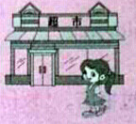

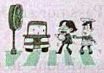

past,over,across与through
辨析：
past 经过
over跨越
across 横穿
through穿过
past | 晚于；从……旁边经过 | 表示时间上“在……之后”或空间上“经过”
over | 从……上方跨过 | 表示空间范围上“越过”
across | 横穿；越过 | 表示动作是在某一物体表面进行的，强调从一端到另一端
through | 穿过；越过 | 表示动作是在某一空间内进行的，强调从内部穿过

Slide 42
The man walked past a shop.
这个人走过一家商店。
There is a bridge over the river.
河上面有座桥。
The little boy is walking across the road.
这个小男孩正在步行穿过马路。
He can go through the forest by himself.
他能独自穿过森林。

Slide 43
5. Pardon? 请再说一遍好吗？
pardon此处为感叹词，意为“再说一遍 ;抱 歉，对不起” 。此处表示没听清或不理解对方的话，希望对方再重复一遍，读时用升调，相 当 于. “Beg your pardon?” 或 “ I beg your pardon?” pardon还可用于做错事道歉时，读时用降调;
要表明自己与对方有不同的见解，可能引起对方不快时，用降调。
I do beg your pardon.
请您一定要原谅我

Slide 44
pardon用作及物动词意为“宽恕；原谅”,后接名词代词动词-ing形式作宾语，也可接双宾语常用结构：
pardon sb. for (doing) sth. “原谅某人做某事”
We must pardon him for his fault.
我们一定要原谅他的过失。
Please pardon me for not having answered your letter.
没有给您回信，请你原谅。

Slide 45
6. But we haven’t even started yet!
但是我们甚至还没有开始呢！
yet副词,意为“还;尚”，常用于否定句或疑问句中,通常置于句未。yet表示说话人期望发生的事情尚未发生,常用于现在完成时。
►They haven't watered the flowers yet.
他们还没有浇花。

Slide 46
7. You don’t need to rush!
你不需要着急！
rush此处用作动词,意为“仓促；急促”。常用短语
rush to do sth. 意为“赶紧/抢着做某事”；
rush to…意为“冲/奔向……”。
She’s always rushing to finish her homework first.
她总是赶着第一个完成作业。
He stood up and rushed to the door.
他站起来向门口冲去。

Slide 47
rush用作名词，意为“勿忙；繁忙”
常用短语：in a rush“匆忙地”，
rush hour“（交通）高峰期；拥挤时刻”。
I found the work being done in a rush.
我发现这件作品正在被仓促赶制。
If you go now, you’re likely to hit the rush hour.
你要是现在走,很有可能会赶上交通 高峰期。

Slide 48
8. I’m excited to try the rides!
be excited to do sth. 对做...感到兴奋
She was excited to learn the news.
她听到这消息很兴奋。
be excited about sth. / doing sth. 对 ... 感到兴奋
Are you excited about your new job?
你对新工作感到兴奋吗？
You must be excited about leaving for America.
对去美国一定很兴奋。

Slide 49
杰克对乘坐飞机去那里旅行感到兴奋。（两种答案）
Jacky was excited to travel there by plane.
Jacky was excited about travelling there by plane.

Slide 50
知识链接
excited 与 exciting 的区别
在句子中都可以用作定语或表语，但它们的意思和在句中的用法有差异。 excited意为兴奋的，一般修饰人；而 exciting 意为令人感到兴奋的，一般修饰物。例如：
Was it an exciting match?
Are you excited about going to Beijing?

Slide 51
类似词语有：
interested / interesting 感兴趣的／有趣的
moved / moving 感动的／令人感动的
surprised／surprising 感到惊奇的／使人惊奇的
pleased / pleasing 高兴的／令人高兴的
bored / boring 厌烦的／令人厌烦的
tired ／ tiring 厌倦的／令人厌倦的
amazed ／ amazing 惊奇的／令人惊奇的
frightened / frightening 受惊恐的／令人惊恐的
puzzled / puzzling 迷惑的／令人迷惑的

Slide 52
3a Read the conversation and answer the
questions below.
Learning strategy: Using suitable language
The culture of a nation is in its language. It
is not enough to only know correct grammar.
It is also very important to know how to
choose suitable language for every situation.

Slide 53
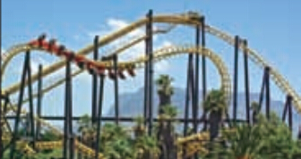
Fun Times Park — Always a Fun Time!
[Alice and He Wei are in Space World.]
Alice: I wonder where we should go next.
He Wei: How about that new ride over there?
Alice: Well ... it looks scary.
He Wei: Come on! I promise it’ll be exciting!
If you’re afraid, just shout
or hold my hand.

Slide 54
[After the ride…]
Alice: You were right! That was fun! I was
scared at first, but shouting did help.
He Wei: See, that wasn’t so bad, right? You
never know until you try something.
Alice: Yes, I’m so glad I tried it.
He Wei: Do you want to go to Water World now?
Alice: Sure, but I’m getting hungry. Do you
know where we can get some good food
quickly?

Slide 55
He Wei: Of course! I suggest Water City Restaurant
in Water World. It serves delicious food.
Alice: Great! Let’s go!
[On their way to Water City Restaurant,
Alice and He Wei pass by Uncle Bob’s.]
Alice: Look! This restaurant looks interesting.
The sign says a rock band plays here
every evening.

Slide 56
He Wei: Why don’t we come back here for dinner
later. Let’s ask what time the band
starts playing.
[Alice and He Wei walk up to a staff
person at the door.]
He Wei: Excuse me, could you tell us when the
band starts playing this evening?
Staff: Eight o’clock. The restaurant is always
busy, so come a little earlier to get a table.
He Wei: OK. Thank you!

Slide 57
1.Why did Alice not want to go on the new
ride? How did she feel after the ride?
Because it looked pretty scary. She felt glad after the ride.
What is special about Uncle Bob’s restaurant? Should Alice and He Wei get there early for dinner? Why?
A rock band seems to play there every evening. Yes, they should. Because it’s always busy.

Slide 58
3b Underline the questions or statements in
the conversation that ask for information.
Rewrite them in a different way.
e.g. I wonder where we should go next.
Could you tell me where we could go next?
Do you want to go to Water World now?
—Would you like to go to Water World now?
2. Do you know where we can get some good food quickly?
— I wonder where we can get some good food quickly.

Slide 59
3. Excuse me, could you tell us when the
band starts playing this evening?
— Excuse me, do you know when the band starts playing this evening?

Slide 60
Language Points
1. If you’re afraid, just shout or hold my hand.
如果你害怕，就喊出来或抓着我的手。
shout 作动词，意为“呼喊;呼叫；大声说”
常用短语：
(l) shout at sb. 意为“冲某人大声叫嚷”，含有
批评、指责的意思。
Don t shout at your parents.
别对你父母大声叫嚷。

Slide 61
(2) shout to sb.意为“对某人大声叫喊”, 没有批评、指责的意思。
He shouted to the girl and warned her of the danger. 他冲那个女孩大喊，警告她有危险。
(3) shout out意为“喊出; 突然呼喊”。
Only a few people are brave enough to shout
out her name.
只有少数人有勇气喊她的名字。

Slide 62
2. I was scared at first, but shouting did help.
起初我很害怕，但喊出来确实有用。
did 此处用作助动词，在句中起强调作用,用来表达说话者的一种强烈的感情。did要重读，后接动词原形，意为“确实：务必；一定；的确”等。 do 随主语人称、数和句子的时态的变化而变化。
He does come from America. 他的确来自美国。
I did make a phone call to you yesterday.
昨天我确实给你打了电话。
Please do be quiet for a moment.
请务必安静一会儿。

Slide 63
3. I suggest Water City Restaurant in Water
World. 我推荐水上世界的水城餐馆。
suggest作及物动同，意为“建议;提议”，其 名词形式为suggestion (建议;提议)。其用法如下：
(l) suggest sth.意为“建议/提议某事”。
► He suggested a two-day-long stay in Beijing on
the way home.
他建议回家时在北京停留两天。

Slide 64
(2) suggest doing sth. 意为“建议/提议做 某事”
►My father suggested calling for a doctor at once.
我父亲建议马上请个医生。
(3)suggest-that引导的宾语从句。此时宾 语从句
要用虚拟语气，即should + 动词原形，其中
should可省略。
► The teacher suggested that we (should) speak
as much English as possible in class.
老师建议我们在课堂上尽可能多地 说英语。

Slide 65
注意：
表示“建议某人做某事”不能用suggest sb. to do sth., 但可以用 advise sb. to do sth.。
译:他建议我听古典音乐。
误：He suggested me to listen to classical music.
正：He advised me to listen to classical music.

Slide 66
4. On their way to Water City Restaurant,
Alice and He Wei pass by Uncle Bob’s.
在他们去水城餐馆的路上，爱丽丝和何伟路
过鲍勃叔叔的参观。
(l) on one’s way to ...意为“在某人去 的路上”。
►I met an old classmate of mine on my way to
work.
在去上班的路上，我遇到了一位老同学。

Slide 67
由way构成的其他短语：
by the way顺便问/提一下
in a way在某种程度上
in the way妨碍;挡道
in this way这样;通过这种方法
lose one’s way 迷路
get out of the way of sth.丢掉......的习惯

Slide 68
(2) Uncle Bob‘s 相与于 Uncle Bob’s restaurant。 当名词所有格限定的是表示住宅、诊所、商店等的名词时，该名词通常省略。
He is going to his aunt’s (house ) this weekend!
这个周末他打算去他姑姑家。
They‘re at the doctor’s (office).
他们在诊所。
He is cutting hair at the barber's (shop).
他正在理发店理发。

Slide 69
拓展：
's所有格省略名词的情况：
①’S所有格所修饰的名词如果前面已出现 过，就可以省略。
This is Jim’s room and that is Tom's.
这是吉姆的房间，那是汤姆的房间。
②在双重所有格结构中，’s所有格后面的名词省略。
a photo of my brother’s 我弟弟的一张照片

Slide 70
I. 单项选择。
1. (2013 •成都)There is a ______ near our
school. We often buy books there.
A. bank B. restaurant C. bookstore
2. (2013 •荷泽）Traveling around big cities by
taxi can cost a lot of money，but it’s usually
_____ to take the underground train to most
places.
  A. amazing B. expensive
  C. convenient D. exciting
C
C

Slide 71
3. (2013 •长沙) —It’s too late. I have to go now.
—Oh, it's raining outside. Don’t leave ____
it stops.
A. since B. until C. while
4. (2013•襄阳）— What do you often do _____
classes to relax yourselves?
—We often do eye exercises, listen to music
or do some running around the school.
    A. in B. among
    C. between D. through
B
C

Slide 72
5.(2013•内江) The old man is a good swimmer,
and even now he often swims ____ Tuojiang
River after supper.
A. over B. through C. to D. across
6. He ____ half a year learning how to drive.
A. cost B. took C. paid D. spent
7. There is a bank ____ the second floor.
A. at B. on C. in D. with
D
D
B

Slide 73
8. Could you tell me ____the library?
  How to get to B. how to get
  C. how get to D. how get
9. —Would you like ____ a movie with us tonight?
— Sorry, I have to help my mother do some
chores.
A. see B. seeing C. to see D. to seeing
10.On my way ___ school, I go ___ a fruit shop
everyday.
    to; pass B. to; past
    C. in; pass D. of; past
A
C
B

Slide 74
II. 根据句意及汉语提示完成单词。
Tom sent me some beautiful _______(邮票)
last week. I like them very much.
2. Joe never gave a ______(直接的) answer to any question of the reporters.
3. I live next to a supermarket. It’s very __________ (方便的).
4. The cinema is _______(在……旁边) our school.
5. What are your name and ________(地址)？
stamps
direct
convenient
besides
address

Slide 75
III. 完成句子
1. 打扰了，请你告诉我在哪能买到字典好吗？
_____ _____. Could you please tell me _____ _____ _____ get a dictionary?
2. 你能告诉我怎样去邮局吗？
Could you tell me _____ _____ get to the post office?
3. 你能告诉我在新城是否有一些好的博物馆吗？
Could you please tell me _____ _____ _____ any good museums in Newtown?
Excuse me
where
I can
how to
if there are

Slide 76
4. 打扰了，请你告诉我在哪里能买到太阳镜好吗？
____ ____. Could you please tell me ____ ____ ____ get sunglasses?
5. 你知道附近有餐馆吗？
Do you know ____ ____ ____ any restaurants around here?
6. 请你告诉我怎样去颐和园好吗？
_____ ______ tell me _____ ____ get to the
Summer Palace?
Excuse me
where I
can
if there are
Could / Can you
how to

Slide 77
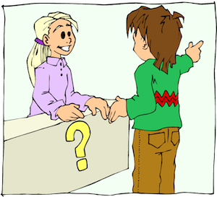
7. 乘电梯到三楼，然后向左拐。
_____ the escalator _____ the third floor, then
____ ____.
8. 在二楼有一家书店。
_______ a bookstore _______ _______ _____
floor.
Take
to
turn left
There’s
on the second

Slide 78
合成句子:
1 We don’t know. Where can we buy a stamp?
_____________________________________________
2 Where is the tea shop? Could you tell me?
_____________________________________________
We don’t know where we can buy a stamp.
Could you tell me where the tea shop is?
写出同义句：
1 I don’t know what I shall do next.
____________________________________
2 The students didn’t know what present to give their teacher for Teachers’ Day.
_____________________________________________________________________
I don’t know what to do next.
The students didn’t know what present they should give their teacher for Teachers’ Day.

Slide 79

Homework
Make a conversation about how to get to a place.
Master the words in this unit and pre-view next part.

